Slide 1

Speakers
Bhavik Ardeshna, Ishita Chauhan, Kirtan Soni, Jwalit Shah
WEB DEVELOPMENT
&
ML TEAM

Slide 2




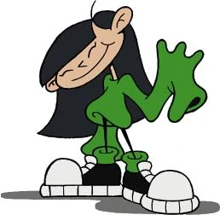
Event Speakers
Ishita Chauhan Bhavik Ardeshana Jwalit Shah Kirtan Soni

Slide 3
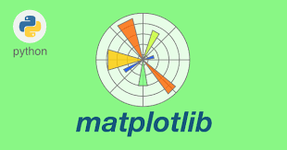
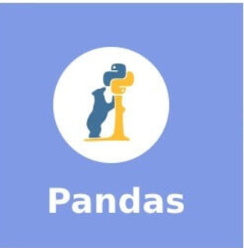
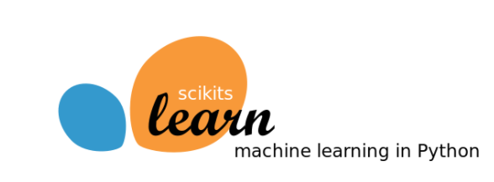
Prerequisites

Slide 4
Matplotlib
Matplotlib is an open-source library that aids in graph plotting.
Matplotlib facilitates one with 2D plotting capabilities for visualization
Notes:
Matplotlib is a comprehensive library for creating static, animated, and interactive visualizations in Python.

Slide 5
Pandas
Pandas stands for “Python Data Analysis Library”
Pandas takes data (like a CSV or TSV file, or a SQL database) and creates a Python object with rows and columns called data frame.
Notes:
Used for data manipulation

Slide 6
Sklearn
The sklearn library contains a lot of efficient tools for machine learning and statistical modeling including classification, regression, clustering and dimensionality reduction.
It should not be used for reading the data

Slide 7
Flask
Web Framework
Speaker Name
Ishita Chauhan
@ishita__0202

Slide 8
What is flask??
Web Framework represents a collection of libraries and modules.
Flask is based on WSGI(Web Server Gateway Interface) toolkit and Jinja2 template engine.
Flask is a web application framework written in Python.
What is framework??
Notes:
Flask is based on theWerkzeug WSGI toolkit and Jinja2 template engine. Both are Pocco projects.
-implements concepts such as request,response objects any other utility..
-jija2 is popular web template in python 2
Combine template with certain datasource to render some dynamic page
modules that enables a web application developer to write applications without having to bother about low-level details such as protocols, thread management etc.
Large community for learners and collaborators, opensource
Its very easy to learn and work with..

Slide 9

Notes:
Django - full stack,high level
Flask- invented to get start webdev quick and easily
Jango - mysql,oracle postgre sql,
but if your application needs nosql db or no database than flask is preferred choice.,mongodb
Jango is fullstack framework
Flask is under category of micro framework
Djagno for large projects
Flask for smaller
But when we talk about performance flask performs slightly better than django because it has smaller & fewer layers
Instagram ,pinterest and udemy using jango ,
Netflix ,raddit are using flask.

Slide 10
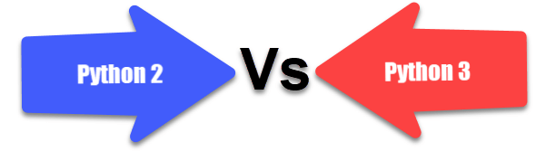
Prerequisites:
Subtitle of a segue slide goes here.
Notes:
Python 2.6 or higher version of python is usually required for installation of Flask.
Although Flask and its dependencies work well with Python 3 (Python 3.3 onwards), many Flask extensions do not support it properly.
Hence, it is recommended that Flask should be installed on Python 2.7.

Slide 11
Flask setup in Virtual Environment.
>pip install virtualenv
>Sudo apt-get install virtualenv
>mkdir newproj
>cd newproj
>virtualenv venv
>venv/bin/activate
>venv\scripts\activate
>pip install Flask
Notes:
The following command installs virtualenv.
pip install virtualenv
This command needs administrator privileges. Add sudo before pip on Linux/Mac OS. If you are on Windows, log in as Administrator. On Ubuntu virtualenv may be installed using its package manager.
Sudo apt-get install virtualenv
Once installed, new virtual environment is created in a folder.
mkdir newproj
cd newproj
virtualenv venv
To activate corresponding environment, on Linux/OS X, use the following:
venv/bin/activate
On Windows, following can be used:
Venv\scripts\activate
We are now ready to install Flask in this environment.
pip install Flask

Slide 12
# Your First Flask Code
from flask import Flask
app = Flask(__name__)
@app.route('/')
def hello_world():
return 'Hello, World!'
# Add this content to the Hello.py and execute the python file.
Notes:
Importing flask module in the project is mandatory.
An object of Flask class is our WSGI application. Flask constructor takes the name of current module (__name__) as argument.
The route() function of the Flask class is a decorator, which tells the application which URL should call the associated function.
In the above example, ‘/’ URL is bound with hello_world() function. Hence, when the home page of web server is opened in browser, the output of this function will be rendered.
Finally the run() method of Flask class runs the application on the local development server. app.run(host, port, debug, options)
App routing is used to map the specific URL with the associated function that is intended to perform some task. It is used to access some particular page like Flask Tutorial in the web application.
In our first application, the URL ('/') is associated with the hello_world function that returns a particular string displayed on the web page.

Slide 13
Routing
one more approach to perform routing.
using the add_url() function of the Flask class.
Syntax:
add_url_rule(<url rule>, <endpoint>, <view function>)
def about():
return "This is about page"
app.add_url_rule("/about", "about", about)
Notes:
Modern web applications use meaningful URLs to help users.
Users are more likely to like a page and come back if the page uses a meaningful URL they can remember and use to directly visit a page.
Add url rule function is also used to bind the url.

Slide 14
Dynamic Routing
•It avoids hard coding of the URLs.
•We can change the URLs dynamically instead of remembering the manually changed hard-coded URLs.
•It handles the escaping of special characters and Unicode data transparently.
If your application is placed outside the URL root,
for example, in
/myapplication
instead of /,
url_for()
properly handles that for you
Notes:
Url_for () function is used for dynamically building a url for specific function
The fun actually accepts the name of the function as first argument and one or more keywords as other argument

Slide 15
Http method
HTTP - hypertext transfer protocol
Foundation of the data transfer in the world wide web.
All web frameworks including flask need to provide several HTTP methods for data communication.
@app.route('/login', methods=['GET'])
uname = request.args.get('uname')
password = request.args.get('pass')
Notes:
Web applications use different HTTP methods when accessing URLs. You should familiarize yourself with the HTTP methods as you work with Flask. By default, a route only answers to GET requests. You can use the methods argument of the route() decorator to handle different HTTP methods.
GET - sends data in unencrypted form to the server
HEAD- same as get method but without response body
POST-sends html form data to the server
PUT-replace all current representation of target resources with uploaded content
Delete - Delete …. With given url

Slide 16
# in app.py
@app.route('/')
def message():
message = “Hello people..!!!”
return render_template(‘message.html’, msg = message)
# in message.html
<h1> {{msg}} </h1>
Notes:
We have seen that we are writing html in python from , And its cumbersome.
Can we return output of function bound in form of url in form of html??
Flask will try to find html file in templates folder, in the same folder in which the script is present
To render a template you can use the render_template() method. All you have to do is provide the name of the template and the variables you want to pass to the template engine as keyword arguments. Here’s a simple example of how to render a template:

Slide 17
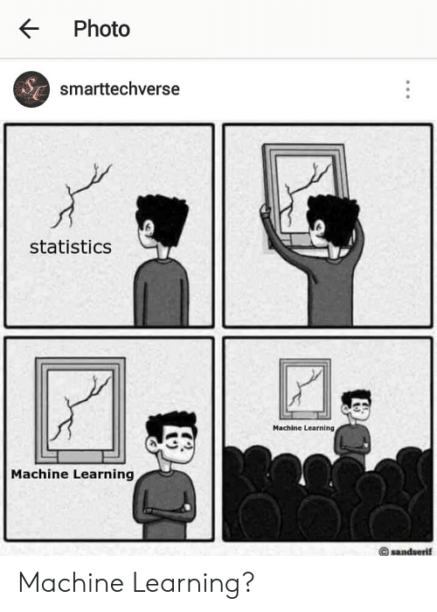
MACHINE
LEARNING

Slide 18
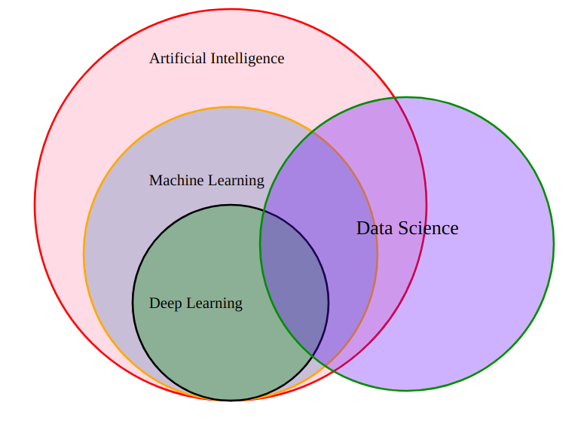
AI vs ML vs DL vs DS
AI :
Enables machines to think
ML:
Statistical tools to explore and analyze the data.
DL:
Can we make our machines to learn,like we human use our brain to learn things??
Notes:
Ai: without any human interaction machine will be able to take its own decision
A self driven car is example of ai application
An application which is using machine learning and deep learning within them is ai application
ML:
Subset of ai
What machine learning helps us to do?
It provides us statistical tools to explore the data.
DL:
Main idea behind dl is to mimic human brains
DS:
Is technique which try to apply all these particular part apart it it also uses some tools ,statistic , probability ,linear algebra ,

Slide 19
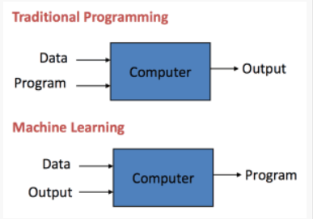
Why Machine learning!?
Data is the lifeblood of all the businesses.
ML applications learn from experience (well data) like humans without direct programming. When exposed to new data, these applications learn, grow, change, and develop by themselves. In other words, with Machine Learning, computers find insightful information without being told where to look.
Machine learning can be the key to unlocking the value of corporate and customer data and enacting decisions that keep a company ahead of the competition.
Notes:
Machine learning is way better at approaching undefined solutions to problems .
It recognised pattern in the dataset automatically without having to define the solution.
AI requires defined pattern to look for.

Slide 20


Classical Example of DL
Deep Learning algorithm
take in an input image
be able to differentiate one from the other
Notes:
Input layers: makes image into array pixel
Hidden layers: finds patterns in the array of pixels
Output layer : determines output using the patterns determined by the hidden layers

Slide 21

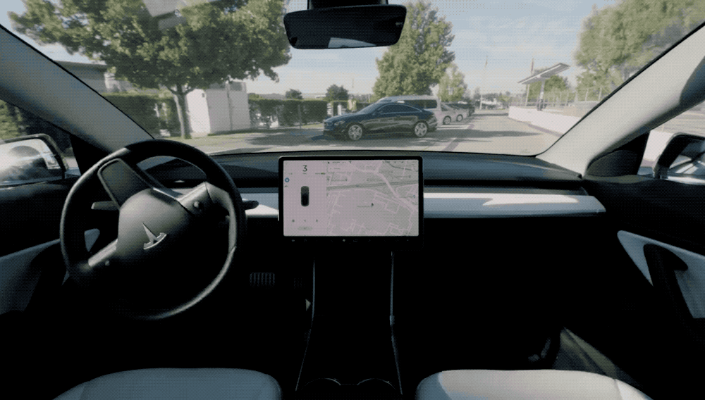
Notes:
Tesla's approach to try to achieve full self-driving (FSD) is to mimic how a human learns to drive,that is, by training a neural network using the behavior of hundreds of thousands of Tesla drivers,by relying chiefly on visible light cameras supplemented by radar and information from components

Slide 22
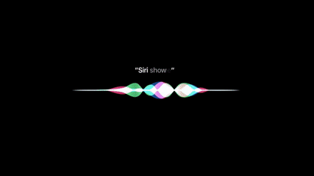
Notes:
Siri is a virtual assistant that is part of Apple .
The assistant uses voice queries, gesture based control, focus-tracking and a natural-language user interface to answer questions, make recommendations, and perform actions by delegating requests to a set of Internet services.

Slide 23
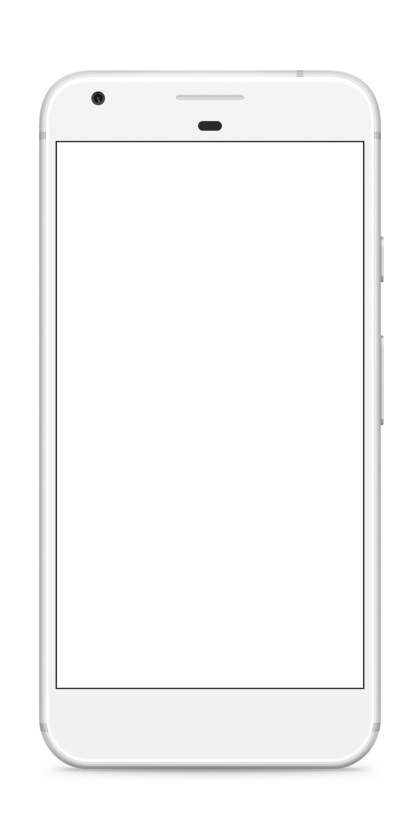

Targeted Advertisement
Have you received relevant advertisements on youtube, instagram?
Amazon suggests products that are relevant to your purchase history.
Notes:
Information such as a user's likes, view history, and geographic location is leveraged to micro-target consumers with personalized products. Social media also creates profiles of the consumer and only needs to look at one place, one the users' profile to find all interests and 'likes'.

Slide 24

Kirtan GO

Slide 25

Linear regression and Random forest.
Kirtan Soni
DSC ML team

Slide 26
Linear Regression
“ Regression analysis is a form of predictive modeling technique which investigates the relationship between a dependent and independent variable.”
Modeled using a straight line ( as the name suggests),
Predicts value of variable.
Accuracy of this model is measured by loss , R squared , adjusted R squared.

Slide 27
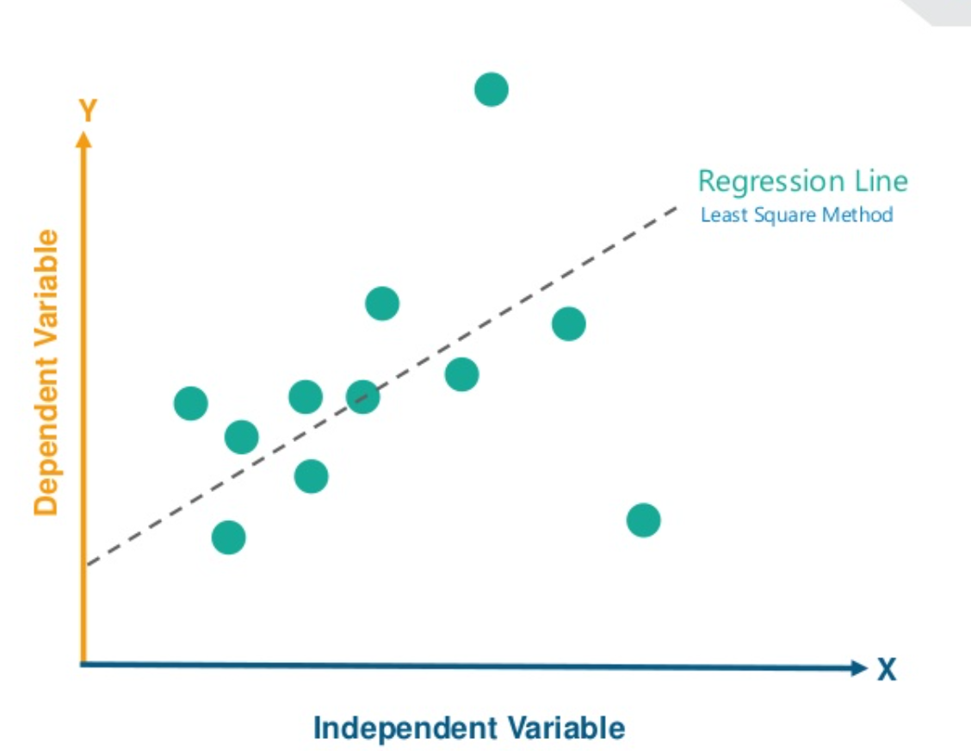
Coordinate explanation
Let us consider our data set be a set of points in x-y plane.
The regression line is the rough linear sketch of the regression line.

Slide 28
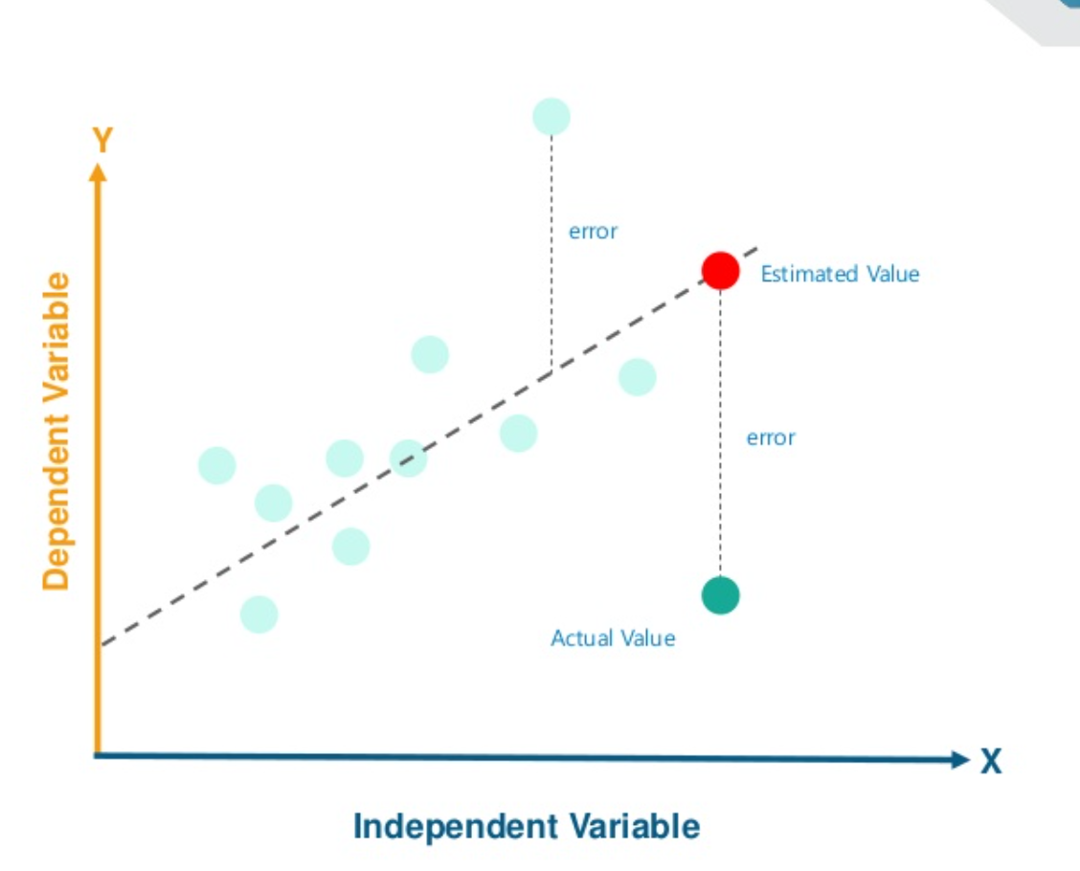
Fitness and accuracy
Now to calculate the fitness of the line we plotted , we will find its loss.
Here i’m going to use R squared method

Slide 29
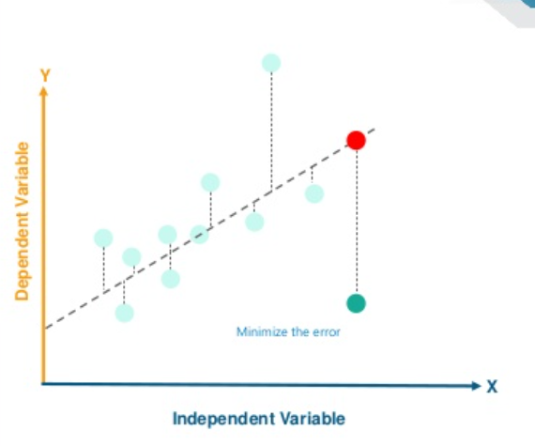
Or main aim is to minimize the error in this model, so when we predict set of y values using the x values , our output is as close to the actual answer as possible

Slide 30
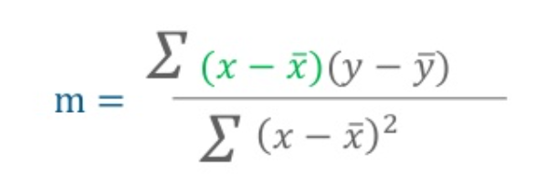
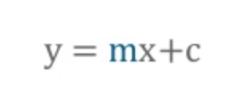
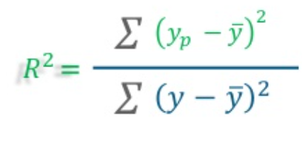
Regression-line & Value
A line requires 2 parameters slope and a constant
R-squared is a goodness-of-fit measure for linear regression models. This statistic indicates the percentage of the variance in the dependent variable that the independent variables explain collectively.

Slide 31
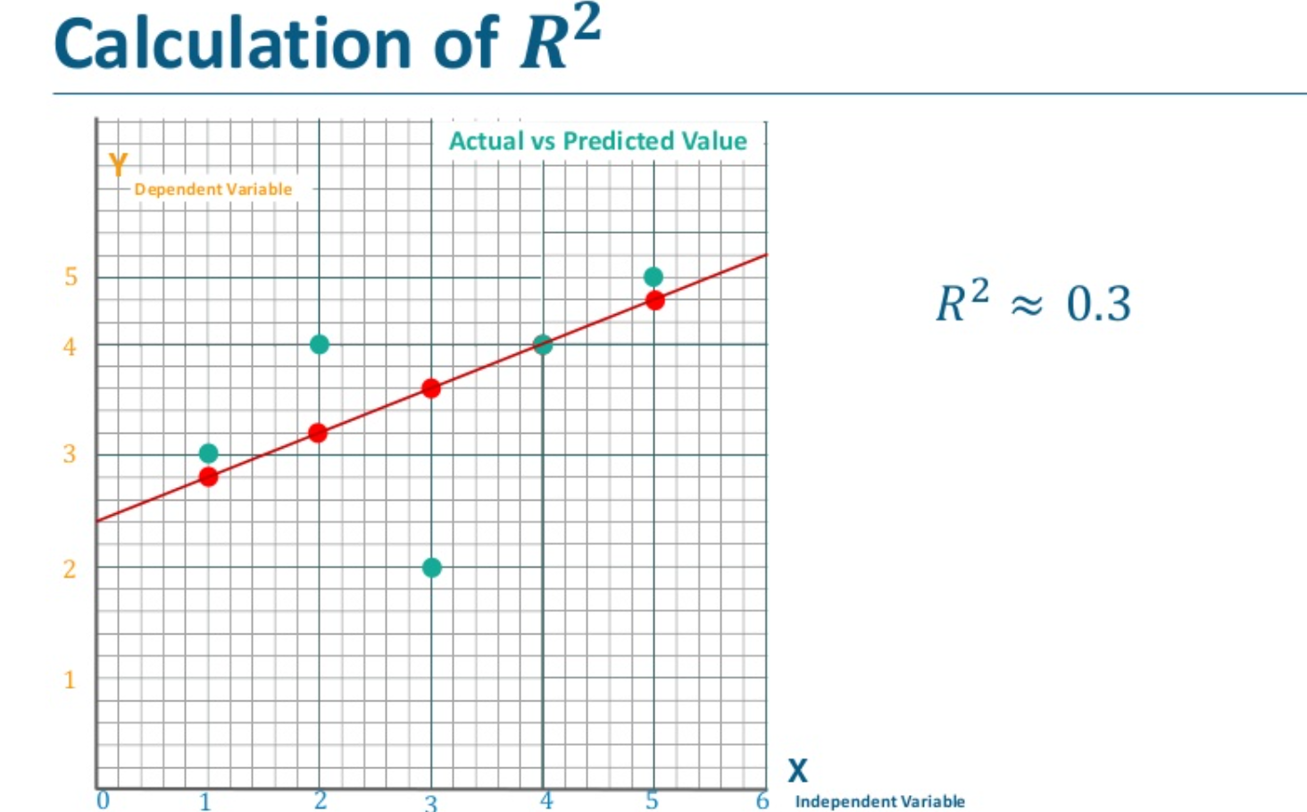
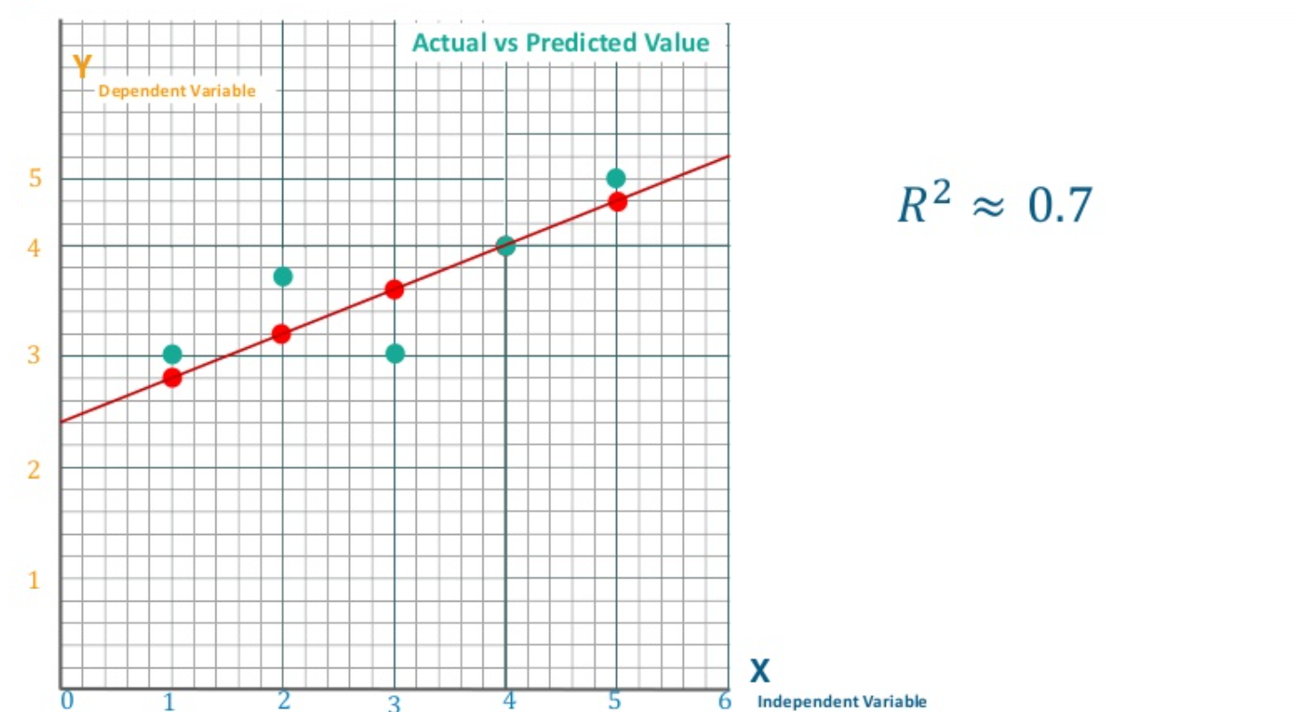

Slide 32
What kind of R² Value is good for a linear regression model?
Ans: Low value doesn't always mean accuracy of the model is bad.

Slide 33
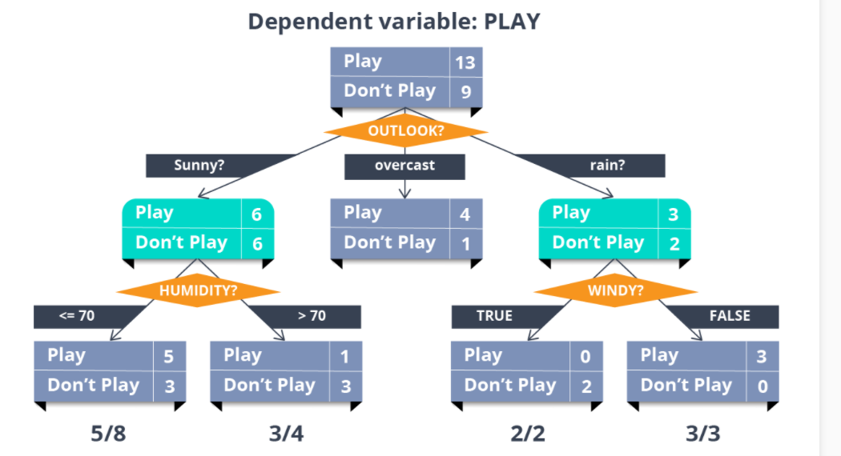
Decision Tree

Slide 34
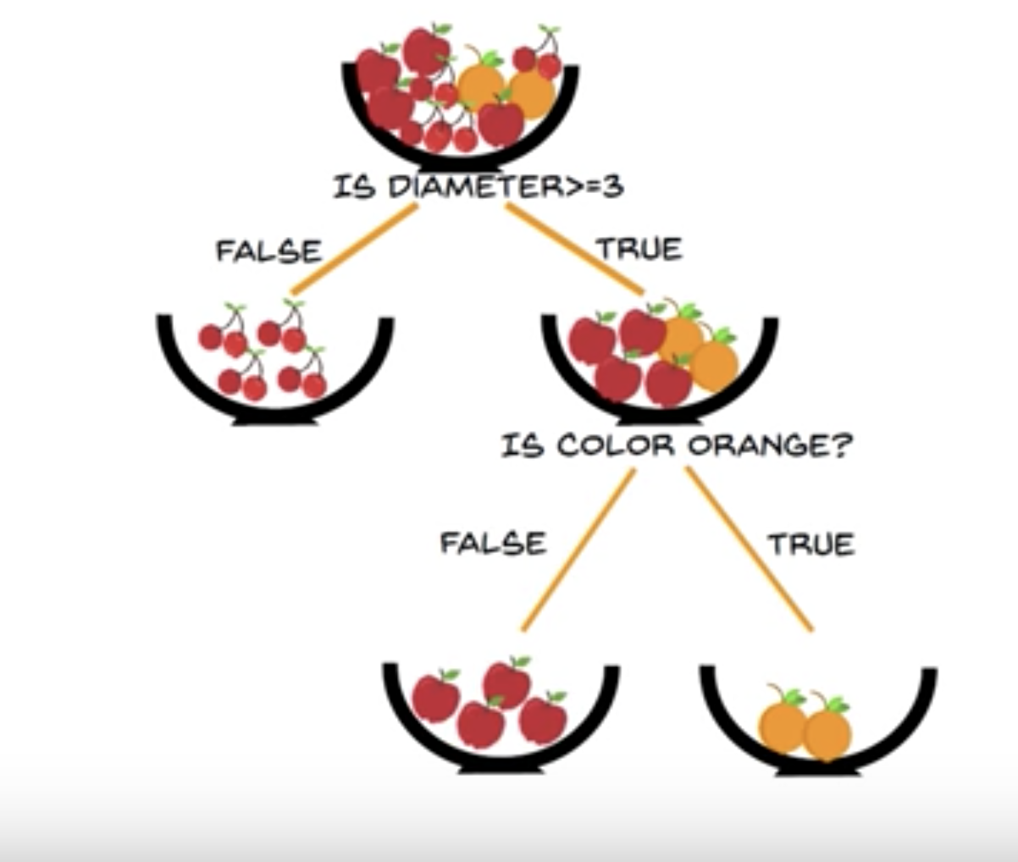
Definition
A decision tree is a flowchart-like structure in which each internal node represents a "test" on an attribute ,each branch represents the outcome of the test, and each leaf node represents a class label. The paths from root to leaf represent classification rules.
Disadvantage
trees that are grown very deep tend to learn highly irregular patterns.they overfit their training sets.

Slide 35

Random Forest

Slide 36
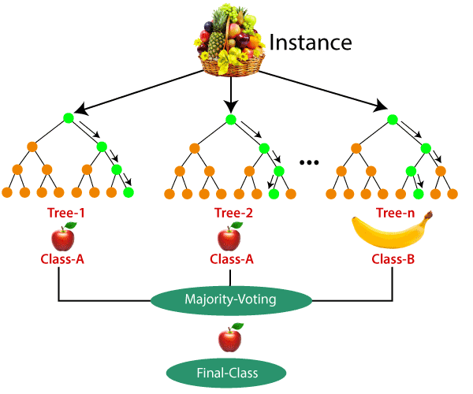
RandomForest
Random forests are a way of averaging multiple deep decision trees, trained on different parts of the same training set, with the goal of reducing the variance.
Taking the teamwork of many trees thus improving the performance of a single random tree.
use a modified tree learning algorithm that selects, at each candidate split in the learning process, a random subset of the features.

Slide 37
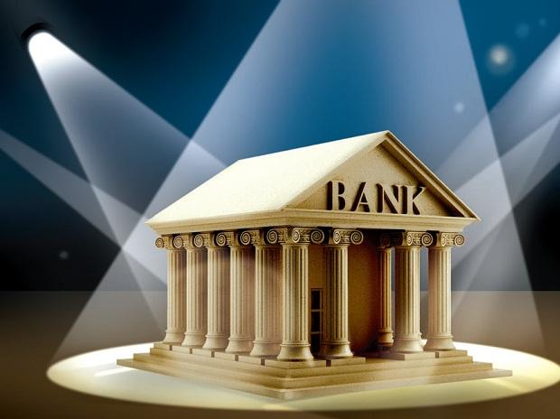
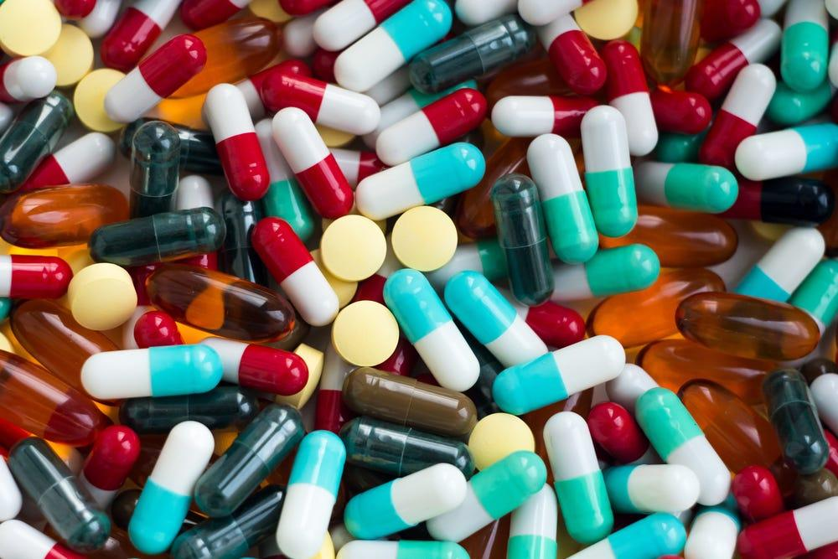
Use-Case
Banking Sector: The banking sector consists of most users. There are many loyal customers and also fraud customers.Random forest analysis uses a set of a random algorithm which identifies the fraud transactions by a series of the pattern.
Medicines: Medicines needs a complex combination of specific chemicals. Thus, to identify the great combination in the medicines, Random forest makes it easier to detect and predict the drug sensitivity of a medicine. Also, it helps to identify the patient’s disease by analyzing the patient’s medical record.

Slide 38

Speaker
Bhavik Ardeshna
Email : ardeshnabhavik@gmail.com
GitHub : Bhavik-Ardeshna

